Slide 1
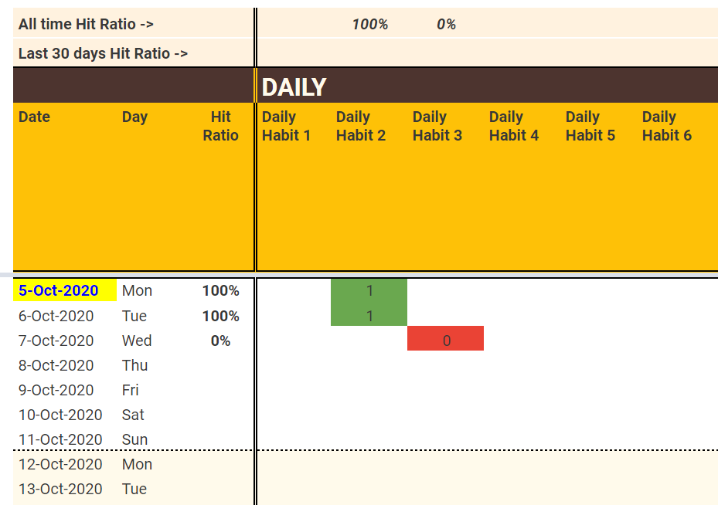
Add the list of habits that you want to track
Enter start date (preferably a Monday)
Enter 1 if you succeeded, 0 if not

